Slide 1
Data Integrity On The Cloud
Kurt Schneider

Slide 2
Methods
Authenticated Dictionaries
Provable Data Possession (PDP)
Dynamic Provable Data Possession (DPDP)

Slide 3
Authenticated Dictionaries
Three parties
Trusted source – defines a finite set of elements that can change over time through insertions and deletions of key-value pairs.
Untrusted server – keeps a copy of the set along with authentication information sent from the trusted source.
Client – queries the untrusted server. The server provides yes/no response to the query along with a proof of the response assembled from the authors signature. This prevents the untrusted server from “guessing” the proof associated with the look up value.
Often the trusted source and the client are the same entity.
The data structure used and the protocol used for queries and updates define the authenticated dictionary.

Slide 4
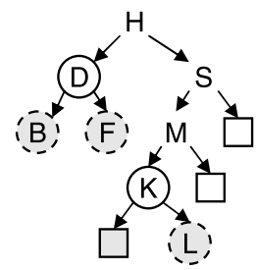
Authenticated Dictionary Using Trees
Merkle Tree
Each node contains a key-value pair and two child pointers.
Each node also contains a value f(x), where f(x) = H(key, H(val), f(l), f(r)), where l and r are the nodes two children and H is a collision resistant cryptographic hash function(SHA1, SHA2, SHA3).
If the root hash of the tree is signed by the trusted source, the server can prove membership of key by showing a path from the root to the key. The client can recompute the roots hash value and compare it to the signed one.

Slide 5
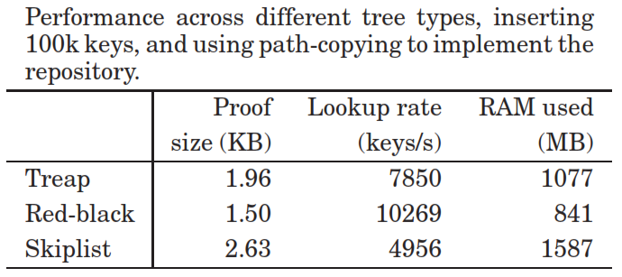
Design Choices
Path copy is to make a copy of all nodes on the path which contains the node we are about to insert or delete. The data structure must be updated so that all nodes that pointed to the old node must be modified to point to the new node instead.

Slide 6
Provable Data Possession (PDP)
Clients need to be able to verify that a server has the proper data without retrieving the data from the server and without having the server check the entire file.

Slide 7
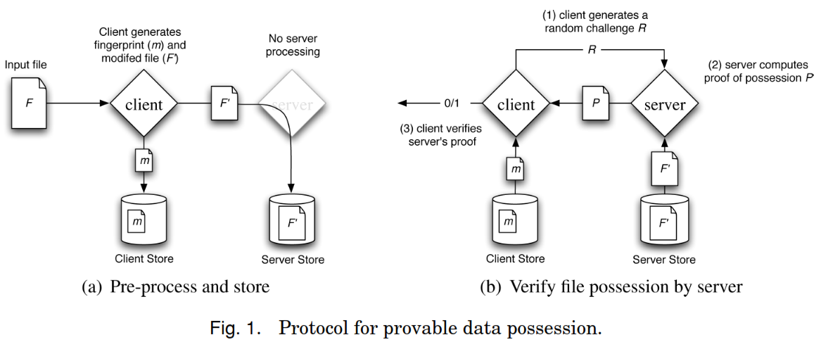
PDP Protocol

Slide 8
PDP Algorithms
KeyGen(1k) → (pk, sk) is a probabilistic key generation algorithm that is run by the client to setup the scheme. It takes a security parameter k as input and returns a pair of matching public and secret keys (pk, sk).
TagBlock(pk, sk, b) → T is an algorithm run by the client to generate the veriﬁcation metadata. It takes as inputs a public key pk, a secret key sk, and a ﬁle block b, and returns the veriﬁcation metadata Tb
GenProof(pk, F, chal,) → V is run by the server in order to generate a proof of possession. It takes as inputs a public key pk, an ordered collection F of blocks, a challenge chal, and an ordered collection which is the veriﬁcation metadata corresponding to the blocks in F. It returns a proof of possession V for the blocks in F that are determined by the challenge chal.
CheckProof(pk, sk, chal, V) →{“success”, “ failure”} is run by the client in order to validate a proof of possession. It takes as inputs a public key pk, a secret key sk, a challenge chal, and a proof of possession V. It returns whether V is a correct proof of possession for the blocks determined by chal.

Slide 9
Dynamic Provable Data Possession (DPDP)
PDP only applies to static, archival storage. DPDP extends PDP so a client can update (insert, delete or modify a block) the outsourced data while maintaining the data possession guarantees.
Dynamic solution is achieved with a variant of an authenticated dictionary (skip list) where rank information is used to organize dictionary entries.
This new structure supports sufficient verification of the indices of the blocks.

Slide 10
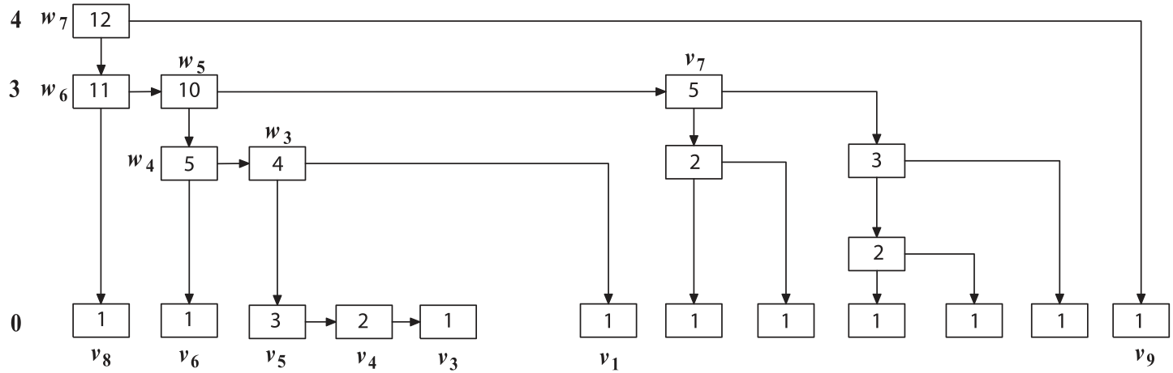
Rank-based Skip List

Slide 11
DPDP Algorithm
Same as PDP with these additions:
PrepareUpdate(sk, pk, F, info, M →{e(F), e(info), e(M)} is an algorithm run by the client to prepare (a part of) the ﬁle for untrusted storage. The client sends the output to the server.
PerformUpdate(pk, F, M, e(F), e(info), e(M)) →{F ,Mi, Mc, P} is an algorithmrun by the server in response to an update request from the client.
VerifyUpdate(sk, pk, F, info, Mc, Mc’, PMc’) →{accept, reject} is run by the client to verify the server’s behavior during the update

Slide 12
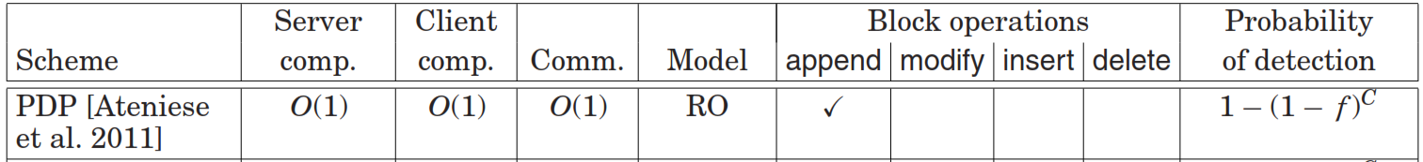
DPDP vs PDP
N is the number of blocks, f is the fraction of corrupted blocks and C is a constant. Server comp. is the time it takes the server to update or complete a proof of a block. Client comp. is the time taken to verify a proof by the client. Comm. Is the size of the proof given to the client from the server. DPDP has the same probability detection as PDP

